Slide 1
The problem
Traffic is a major problem in the world, time wasted on a drive where you can’t do anything. A businessman might be on their way to an important meeting, or a parent rushing home to make their child do homework. The problem still stands, but we may be able to produce a solution. We introduce Hive Bus.

Slide 2
Our solution
Bus Efficiency with Car Conveniency.
So, the idea is that cars in the form of hexagons and shall combine and create a bus like type of transportation. And instead of each bus moving individually much like cars, the bus will be much like the air control center, the ACC, each bus will know where the other buses are to avoid collision and traffic. And it will also be powered by electricity meaning it will also help the environment.

Slide 5
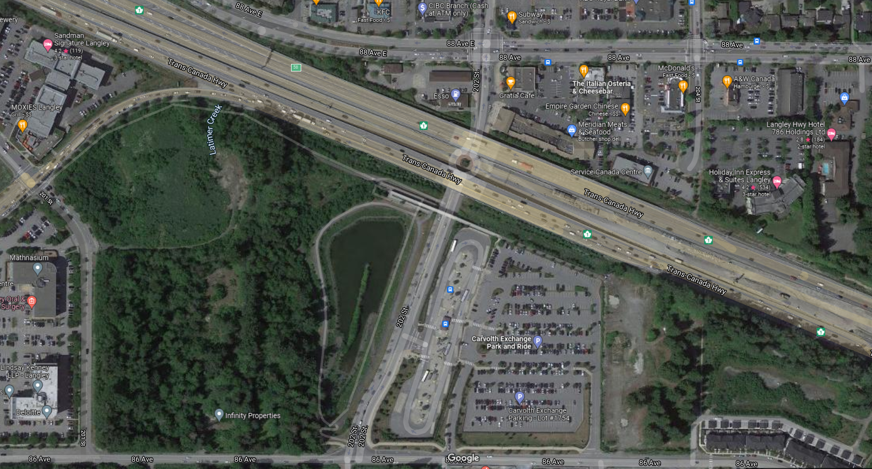
From your Home to your Destination

Slide 6
Parking Efficient

Slide 7
Summary
I

